Slide 1
Uniprocessor Scheduling
Lecturer: Li Yang
Contact: liyang23@swjtu.edu.cn
Office: X31506
Faculty: Computer and AI

Slide 2
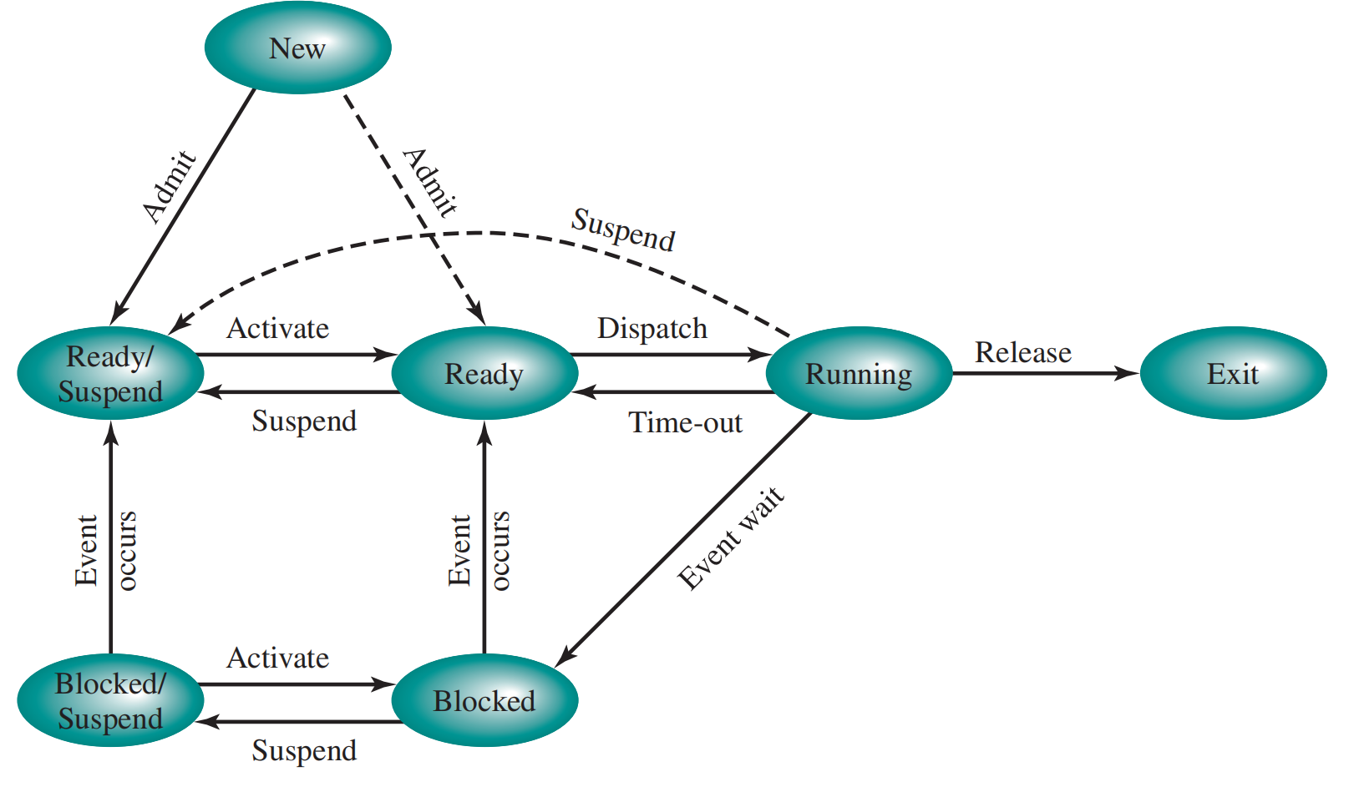
Bridge-In: Seven State Diagram

Slide 3
Queueing Diagram
How many types of scheduling?

Slide 4
Objectives
Type of processor scheduling
  Long-term scheduling
  Medium-term scheduling
  Short-term scheduling
Scheduling Algorithms
  Short-term scheduling criteria
  The use of priorities
  Alternative scheduling policies*
  Fair-share scheduling

Slide 5
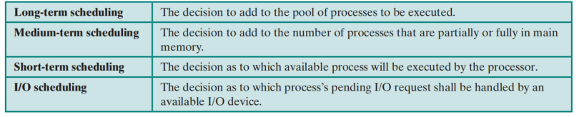
9.1 Processor Scheduling
Key of multiprogramming system: scheduling
Aim to assign processes to be executed by the processor in a way that meets system objectives, such as response time, throughput, and processor efficiency
Four types of scheduling are typically involved:

Slide 6
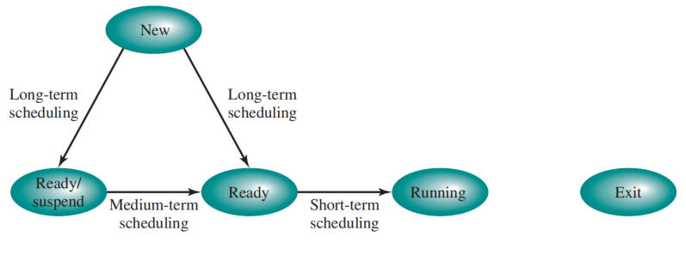
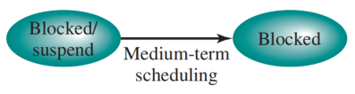
Scheduling and Process State Transitions
Long-term scheduling is performed when a new process is created.
Medium-term scheduling is a part of the swapping function.
Short-term scheduling is the actual decision of which ready process to execute next.

Slide 7
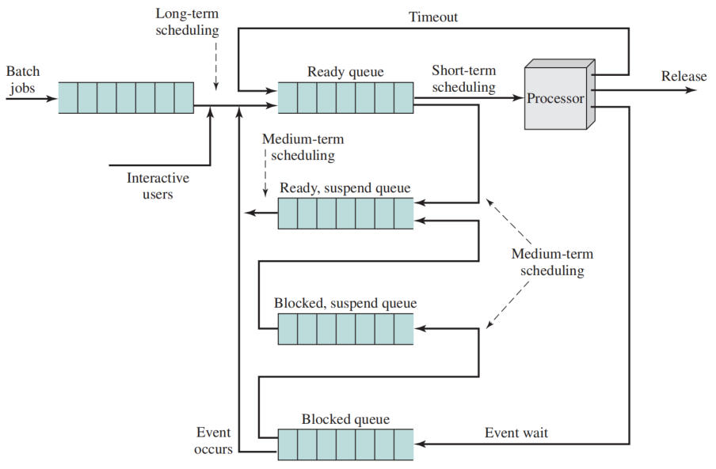
Levels of Scheduling

Slide 8
Long-Term Scheduling
Once a job/user program is admitted it, it becomes a process
Controls the degree of multiprogramming
When to create a new process
  Each time a job terminates
  The time that processor is idle exceeds a certain threshold
Which job to admit
  First come first serve
  priority、service time、I/O requirement，…

Slide 9
Medium-Term Scheduling
Part of the swapping function
Swapping-in decisions are based on the need to manage the degree of multiprogramming
  considers the memory requirements of the swapped-out processes

Slide 10
9.2 Short-Term Scheduling
Known as the dispatcher
Executes most frequently
Makes the fine-grained decision of which process to execute next
Invoked
  when an event occurs blocking of the current process
  preempt （抢占） a currently running process in favor of another
  Examples:
    Clock interrupts
    I/O interrupts
    Operating system calls
    Signals (e.g., semaphores)

Slide 11
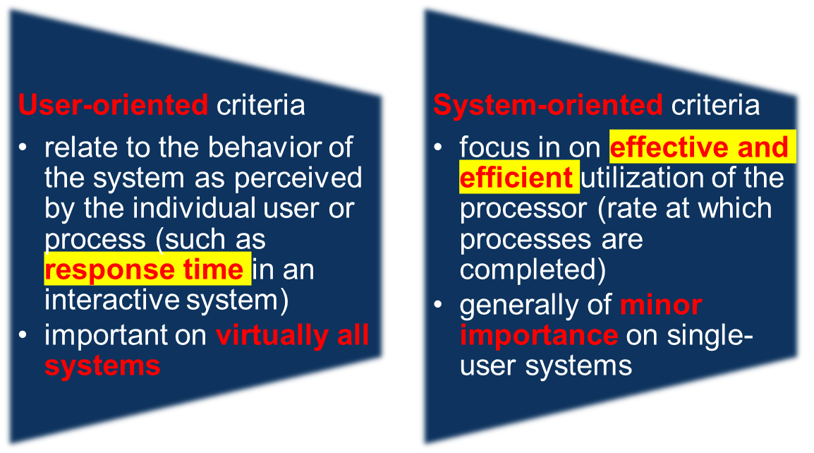
9.2.1 Short Term Scheduling Criteria
A set of criteria is needed to evaluate the scheduling policy

Slide 12
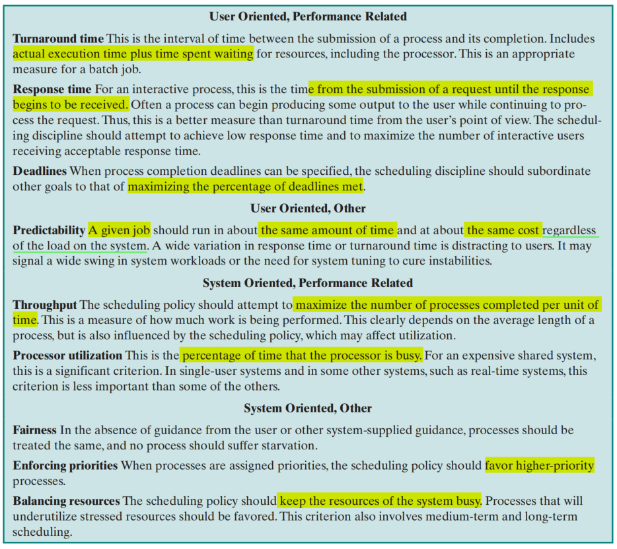
Scheduling Criteria

Slide 13
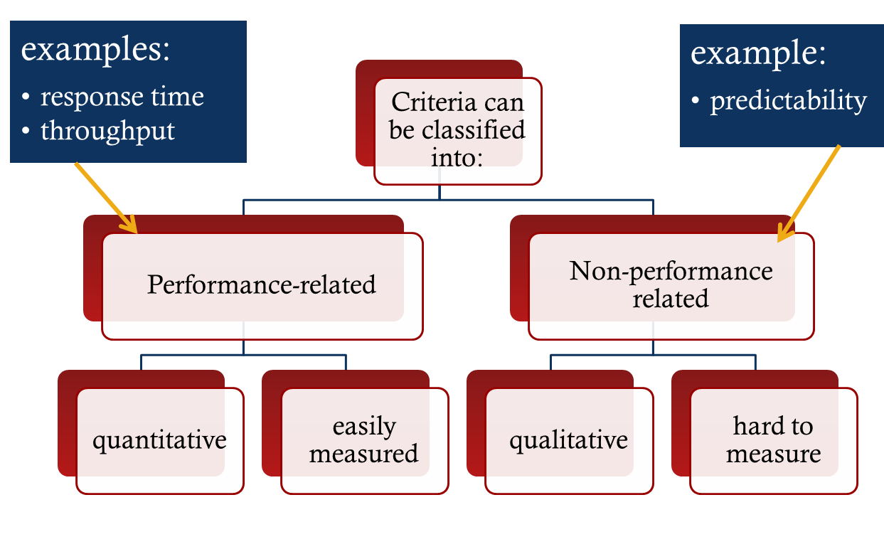
Another dimension

Slide 14
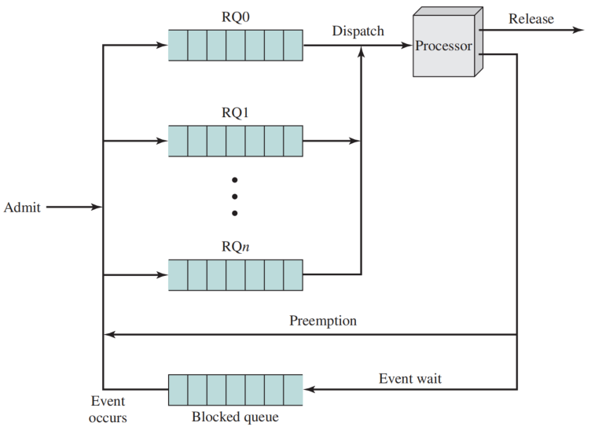
9.2.2 The Use of Priorities
In many systems, each process is assigned a priority, and the scheduler will always choose a process of higher priority over one of lower priority.
larger-priority values represent lower-priority processes
Lower-priority processes may suffer starvation
Priority Queuing
Notes:
饥饿

Slide 15
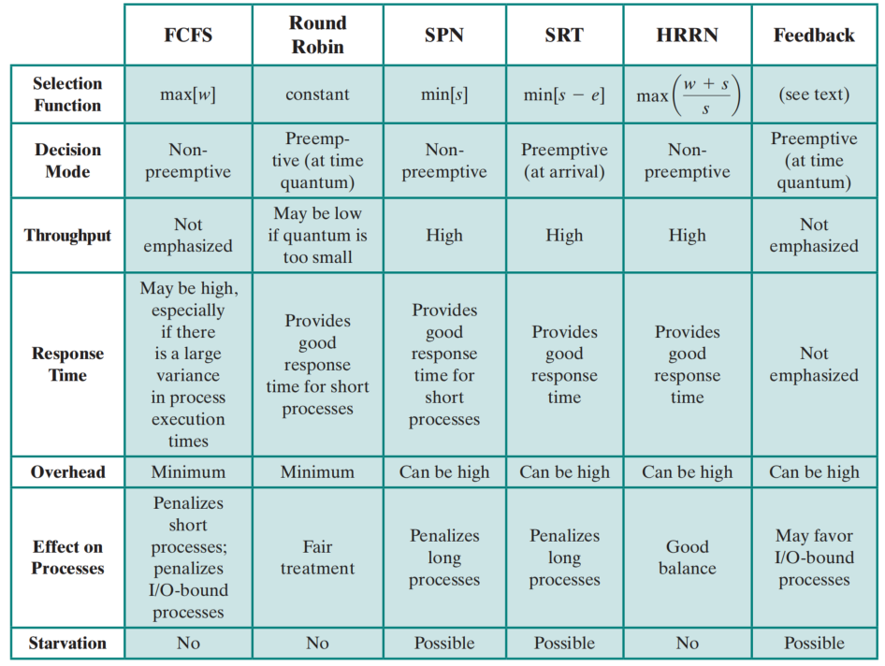
9.2.3 Alternative Scheduling Policies
FCFS: first come first served
RR: Round Robin
SPN: Shortest Process Next
SRT: Shortest Remaining Time
HRRN: Highest Response Ratio Next
FB: Feedback

Slide 16
Selection Function
Determines which process, among ready processes, is selected next for execution
  May be based on priority, resource requirements, or the execution characteristics of the process
  If based on execution characteristics then important quantities are:
    w = time spent in system so far, waiting
    e = time spent in execution so far
    s = total service time required by the process, including e; generally, this quantity must be estimated or supplied by the user

Slide 17
Decision Mode（决策模式）
The decision mode specifies the instants in time at which the selection function is exercised.
Two categories:
  Non-preemptive
    once a process is in the running state, it will continue until it terminates or blocks itself for I/O
  Preemptive:
    currently running process may be interrupted and moved to ready state by the OS
    preemption may occur when new process arrives, on an interrupt, or periodically

Slide 18
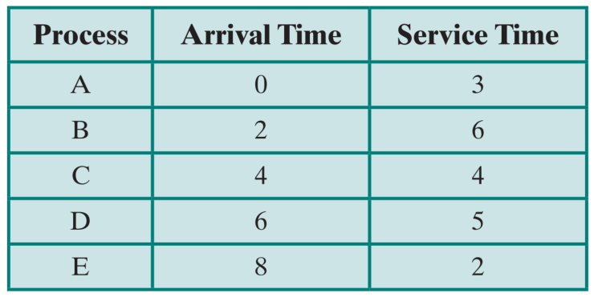
Process Scheduling Example

Slide 19
First-Come-First-Served (FCFS)
Non-preemptive policy
Also known as first-in-first-out (FIFO) or a strict queuing scheme
When the current process ceases to execute, the longest process in the Ready queue is selected
long

Slide 20
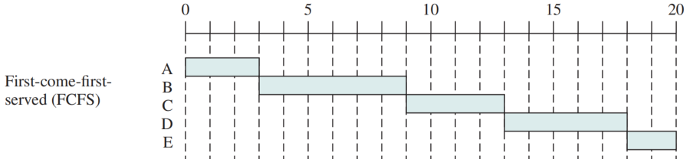
First-Come-First-Served (FCFS)
long

Slide 21
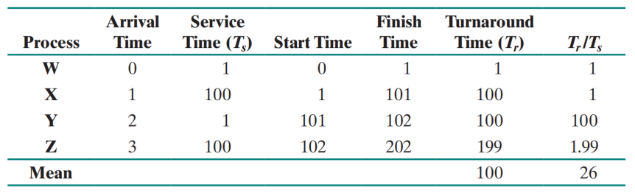
Issues of FCFS
FCFS performs much better for long processes than short ones.
Tends to favor processor-bound processes over I/O-bound processes
✗

Slide 22
Round Robin
Preemptive policy based on a clock
Also known as time slicing because each process is given a slice of time
Particularly effective in a general-purpose time-sharing system or transaction processing system
Principal design issue is the length of the time quantum, or slice, to be used

Slide 23
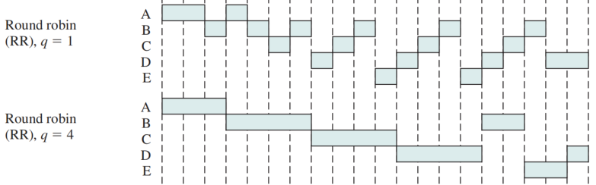
Round Robin
Key point: Put the new arrival process first, then add the just-executed process into the end of queue
Short process are processed quickly
Switch overhead

Slide 24
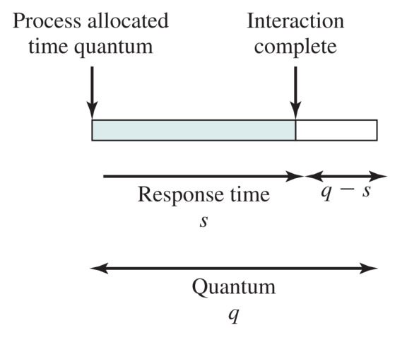
Effect of Size of Preemption Time Quantum
Very short time quanta should be avoided
One useful guide is that the time quantum should be slightly greater than the time required for a typical interaction or process function
(a) Time quantum greater than typical interaction

Slide 25
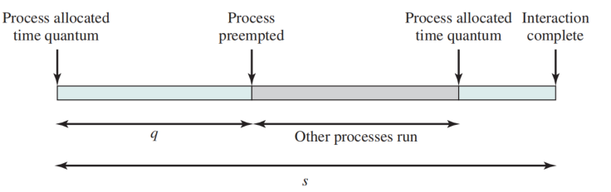
Effect of Size of Preemption Time Quantum
Very short time quanta should be avoided
One useful guide is that the time quantum should be slightly greater than the time required for a typical interaction or process function
(b) Time quantum less than typical interaction

Slide 26
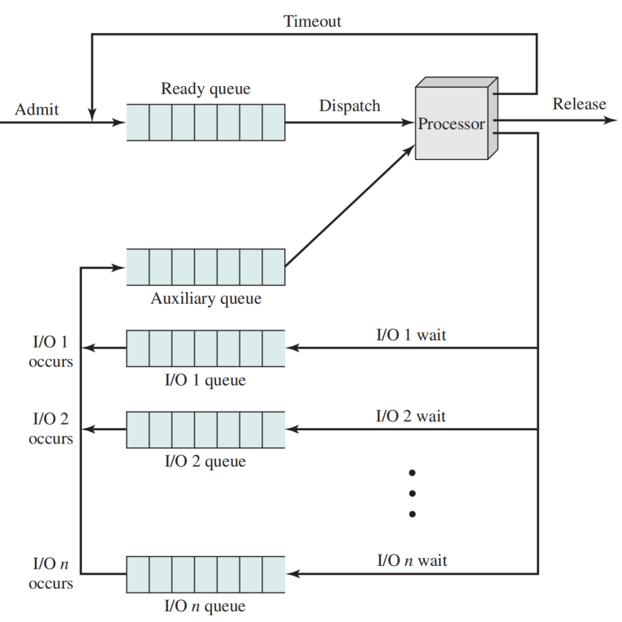

Virtual Round-Robin Scheduler
One drawback is its relative treatment of processor-bound and I/O-bound processes
  An I/O-bound process uses a processor for a short period, then is blocked for I/O;
  a processor-bound process generally uses a complete time quantum
$$q^{a}=q−e$$
Queueing Diagram for Virtual Round-Robin (VRR) Scheduler

Slide 27
Shortest Process Next (SPN)
Non-preemptive policy
The shortest expected processing time is selected next
  Possibility of starvation for longer processes
  One difficulty is the need to know, or at least estimate, the required processing time of each process
  If the programmer’s estimate is substantially under the actual running time, the system may abort the job

Slide 28
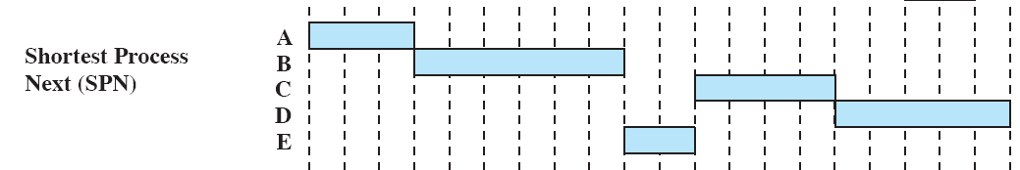
Shortest Process Next (SPN)

Slide 29
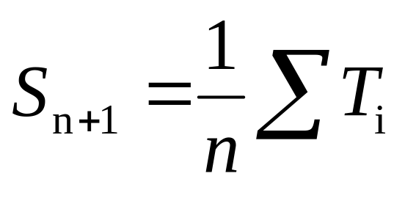
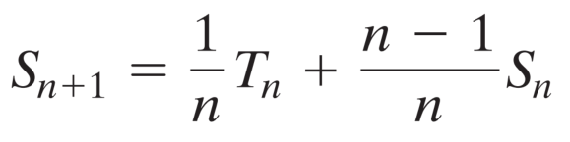
Estimate running time
Simple averaging
equal weight

Slide 30
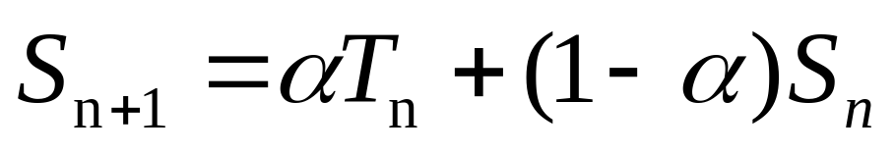


Estimate running time
Exponential averaging，$α∈(0,1)$
  give greater weight to more recent instances, because these are more likely to reflect future behavior.
$$α=0.8$$

Slide 31
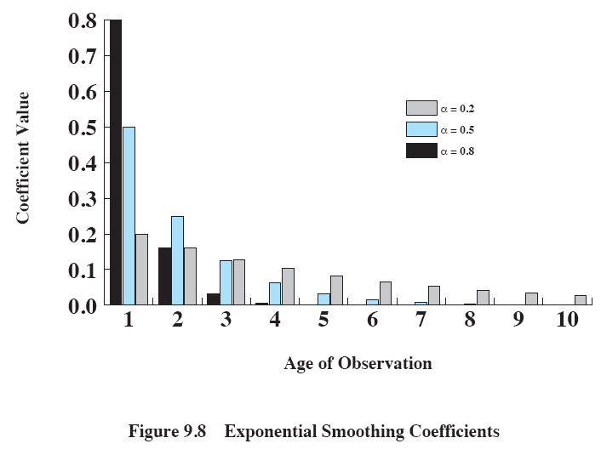
Exponential Smoothing Coefficients

Slide 32
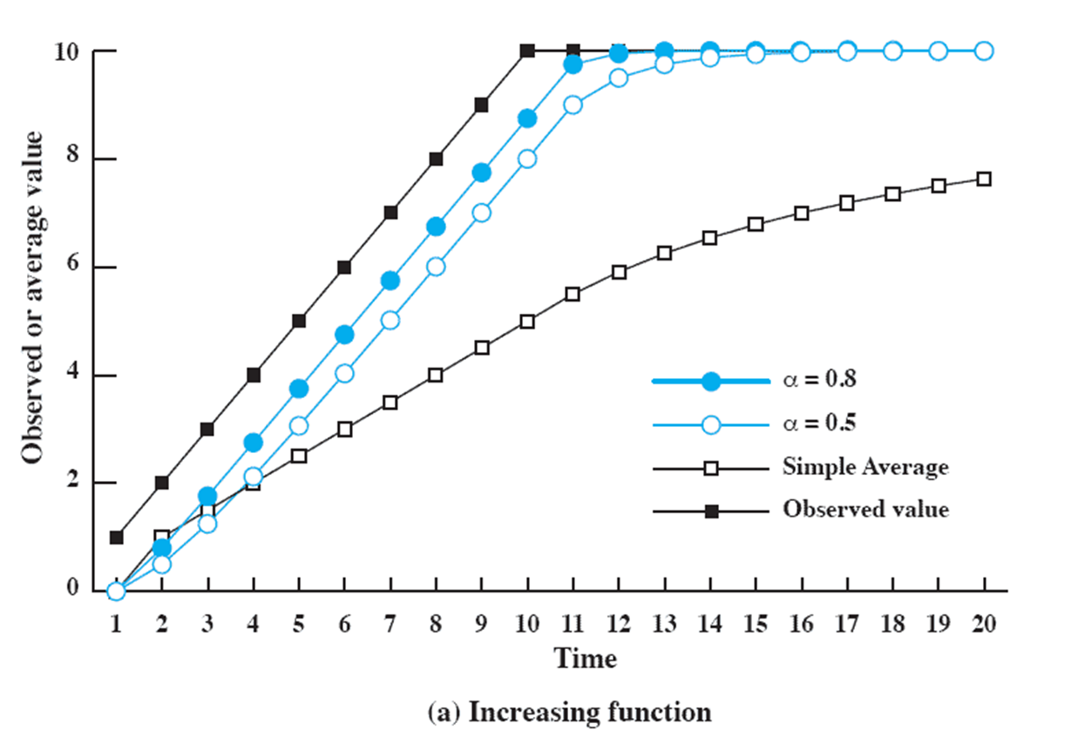
Use Of Exponential Averaging

Slide 33
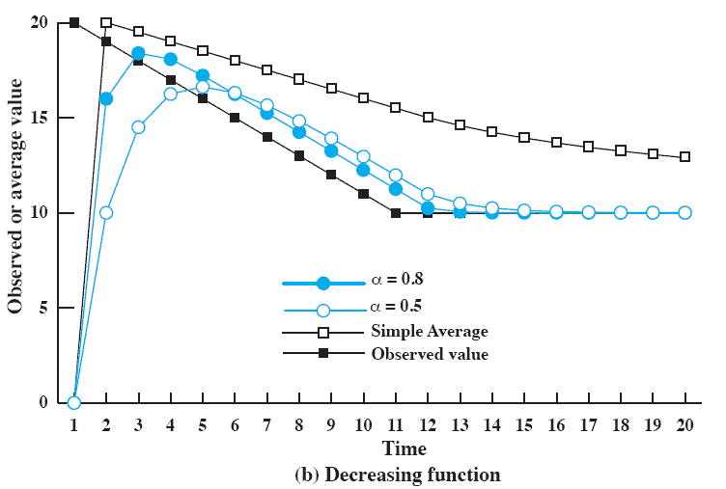
Use Of Exponential Averaging

Slide 34
Shortest Remaining Time (SRT)
Preemptive version of SPN
Chooses the process that has the shortest expected remaining processing time
  have to estimate the processing time
  service times must be recorded, contributing to overhead
  Risk of starvation of longer processes

Slide 35
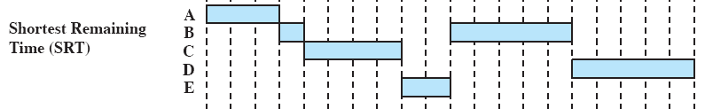
Shortest Remaining Time (SRT)

Slide 36

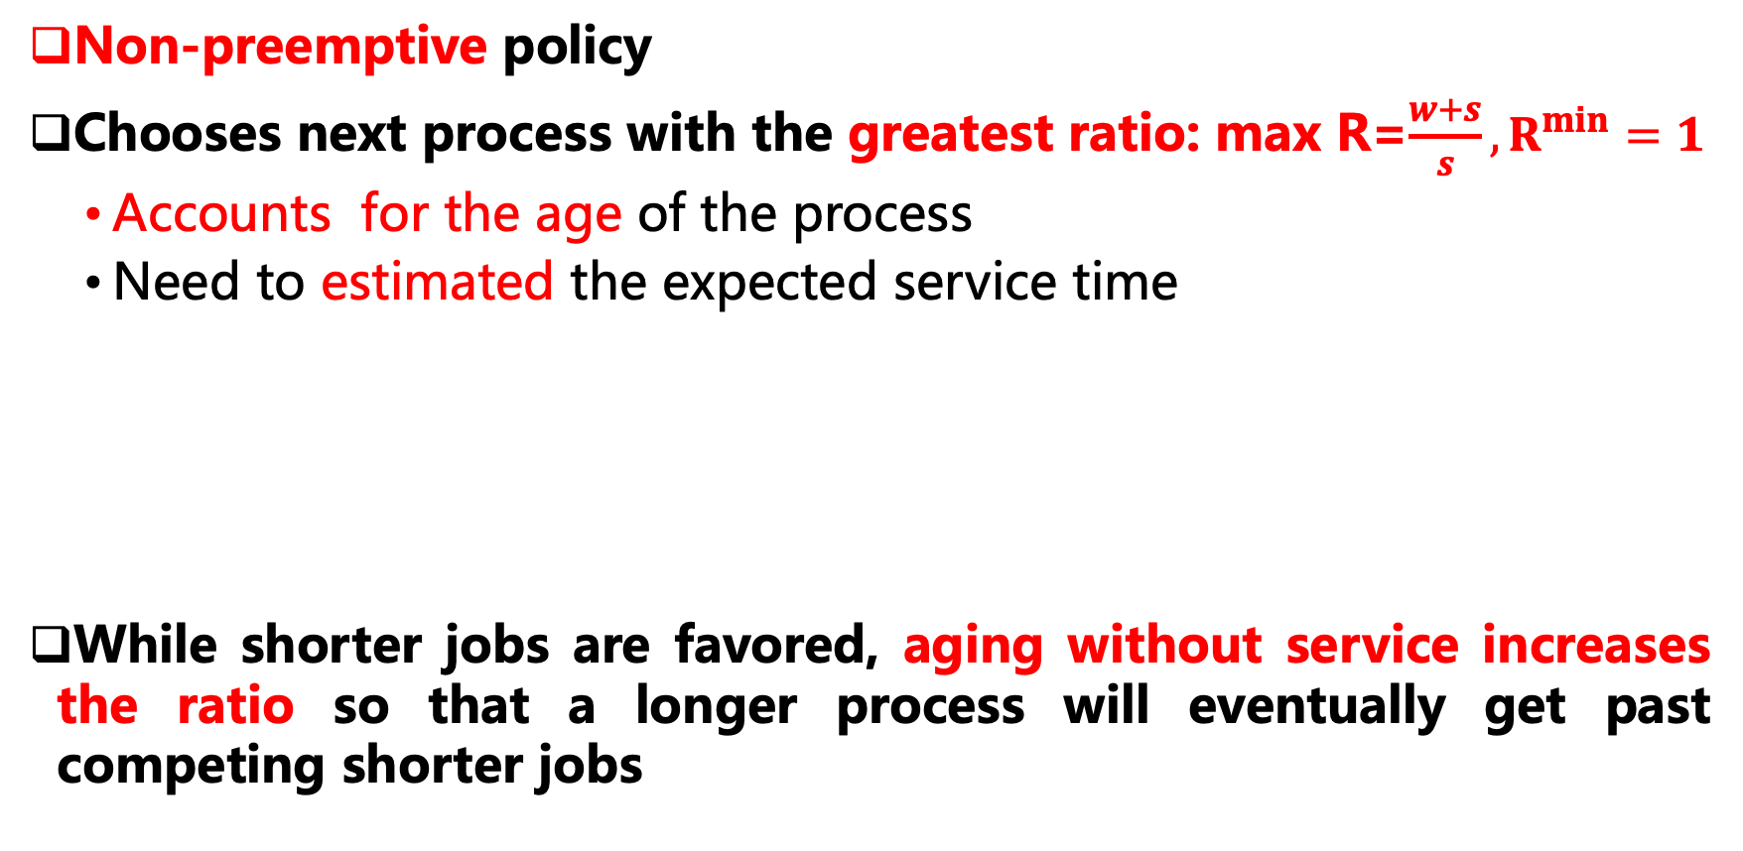
Highest Response Ratio Next (HRRN)
Non-preemptive policy
Chooses next process with the greatest ratio: max R=$\frac{w+s}{s},R^{min}=1$
  Accounts for the age of the process
  Need to estimated the expected service time
While shorter jobs are favored, aging without service increases the ratio so that a longer process will eventually get past competing shorter jobs

Slide 37
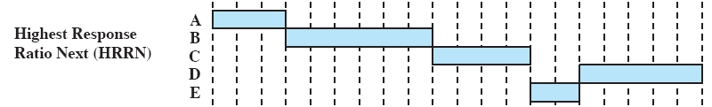
Highest Response Ratio Next (HRRN)
Non-preemptive

Slide 38
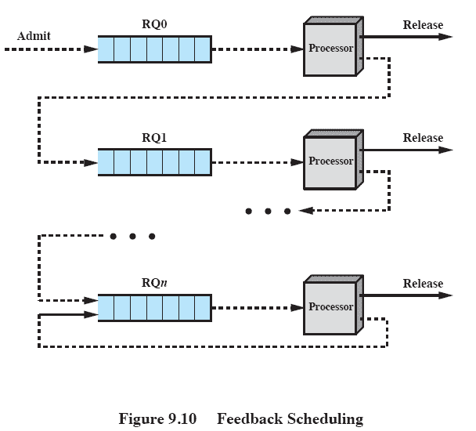
Feedback Scheduling
no indication of the relative length of various processes, then none of SPN, SRT, and HRRN can be used
FB: a process first is placed in RQ0. Then, it is placed in RQ1 after once preemption.
  a preference for shorter jobs
  Different numbers of time slice can be at different queues

Slide 39
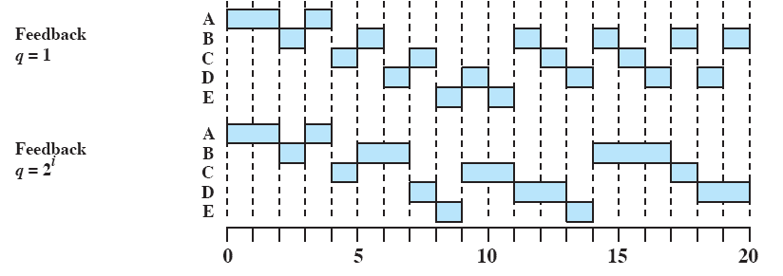
Feedback Performance
Issues: Turnaround time of longer processes is too long in q=1

Slide 40
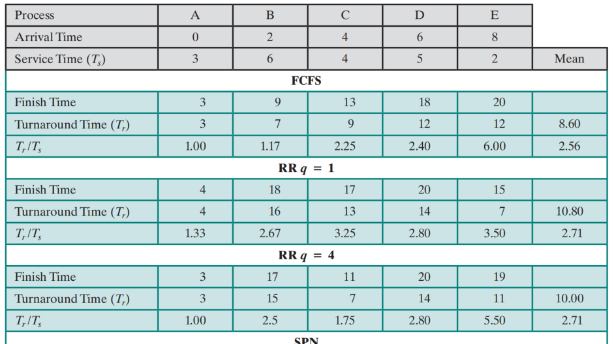

A Comparison of Scheduling Policies

Slide 41
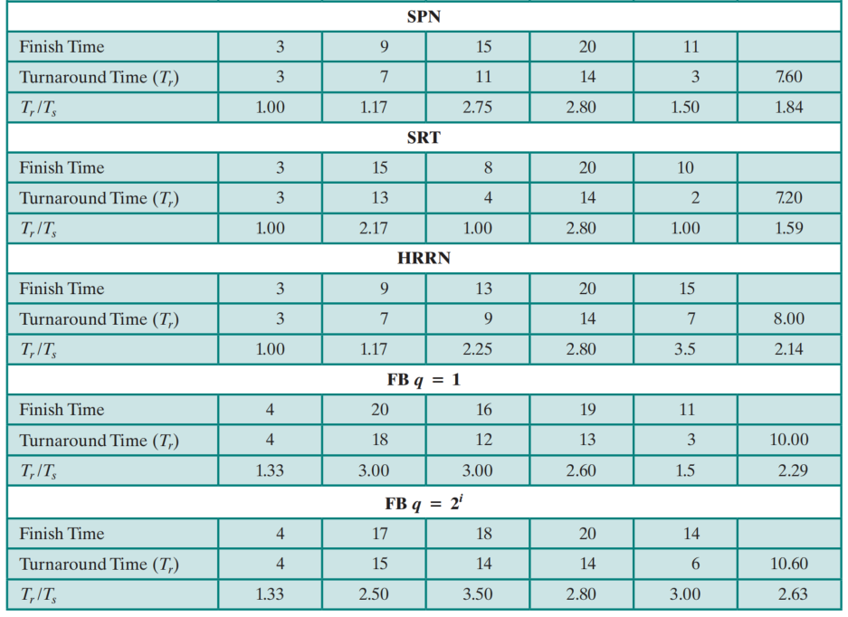
A Comparison of Scheduling Policies （cont.）

Slide 42
Fair-Share Scheduling
Scheduling decisions based on the process sets
  user applications or jobs may be organized as multiple processes
Each user is assigned a share (份额) of the processor
  e.g. four groups, each with 25% of the processor usage
Objective is to monitor usage to give fewer resources to users who have had more than their fair share and more to those who have had less than their fair share

Slide 43
Fair-Share Scheduler Implemented in UNIX
fair-share scheduler (FSS): divides the user community into a set of fair-share groups and allocates a fraction of the processor resource to each group.
Scheduling is done on the basis of priority, the higher the numerical value of the priority, the lower is the priority.
Account for the priority of the process, its processor usage, and the processor usage of the group to which the process belongs,

Slide 44
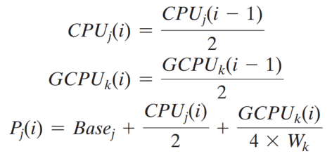
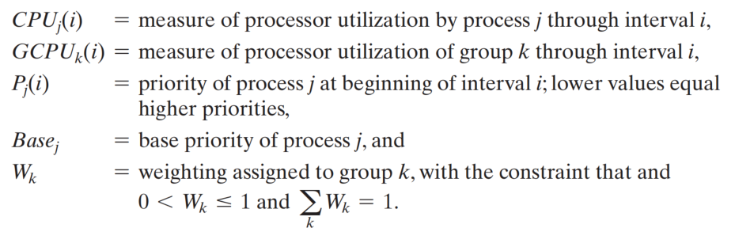
Fair-Share Scheduler (FSS):

Slide 45

Fair-Share Scheduler (FSS):
$W_{k}$=0.5

Slide 46
Summary
The operating system must make three types of scheduling decisions with respect to the execution of processes:
  Long-term
  Medium-term
  Short-term
  From a user’s point of view, response time is generally the most important characteristic of a system; from a system point of view, throughput or processor utilization is important
Scheduling Policies:
  FCFS, Round Robin, SPN, SRT, HRRN, Feedback，fair-share

Slide 47
Quiz

Slide 48
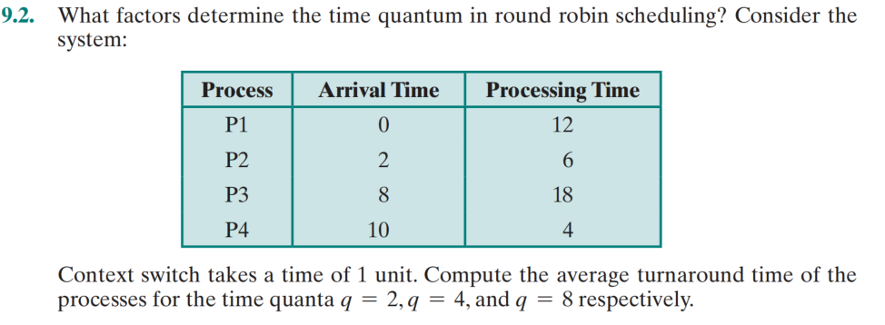
Quiz

Slide 49
Quiz

